Slide 1
Digital Portfolio
STUDENT NAME: ANSIYA A
REGISTER NO:2422K2510
NMID: 53EE73F9ED142AAA5DF4E54A997BA4C2
DEPARTMENT: B.SC CS
COLLEGE: DR.R.V ARTS AND SCIENCE COLLEGE/BHARATHIYAR UNIVERSITY

Slide 2
PROJECT TITLE
Portfolio for Web Developer

Slide 3


AGENDA
Problem Statement
Project Overview
End Users
Tools and Technologies
Portfolio design and Layout
Features and Functionality
Results and Screenshots
Conclusion
Github Link
3/21/2024 Annual Review

Slide 4

PROBLEM STATEMENT
Issue Identification Use browser dev tools, logs, and user feedback to pinpoint the root cause.
Break Down the Problem Divide the issue into smaller, manageable tasks for easier resolution.
Research & Analyze Explore documentation, communities, and similar cases to find the best solution.

Slide 5

PROJECT OVERVIEW
Project Objective Develop a responsive, user-friendly website/web application to meet client or business goals.
Tech Stack Used Utilized HTML, CSS, JavaScript, and frameworks like React / Angular / Node.js / etc.
Key Features Implemented dynamic UI, form validation, API integration, and mobile responsiveness.
Development Process Followed agile methodology: planning, design, coding, testing, and deployment.

Slide 6

WHO ARE THE END USERS?
Clients / Business Stakeholders Companies or individuals who commission and rely on the web product for business goals.
Administrators / Content Managers Users managing backend content, user data, or system settings via dashboards or CMS tools.
Developers / Technical Teams Teams maintaining, scaling, or integrating the system—benefiting from clean, documented code and APIs.
General Users / Customers Individuals accessing the website or app for services, content, or transactions.

Slide 7

TOOLS AND TECHNIQUES
Version Control Git and GitHub/GitLab for tracking changes, collaboration, and code management.
Frameworks & Libraries Use of React, Angular, Vue (front-end) or Node.js, Express (back-end) for faster and modular development.
Testing & Debugging Tools like Chrome DevTools, Jest, and Postman to test APIs, debug code, and ensure functionality
Code Editors & IDEs Tools like Visual Studio Code, Sublime Text, or WebStorm for efficient coding and debugging.

Slide 8
POTFOLIO DESIGN AND LAYOUT
Showcase Key Projects Highlight a selection of best work with descriptions, technologies used, and outcomes.
Clear Structure & Readability Use sections like About, Skills, Projects, and Contact with consistent fonts and spacing.
Clean and Responsive Design Ensure the portfolio adapts seamlessly across devices with intuitive navigation.
Interactive & Visual Elements Incorporate animations, hover effects, and visuals to engage viewers without overwhelming
8

Slide 9
FEATURES AND FUNTIONALITY
Dynamic Content Management Implement CMS or API integrations to easily update and manage content.
Interactive Elements Use animations, forms, and real-time feedback to engage users.
User-Friendly Interface Design intuitive navigation and responsive layouts for seamless user interaction.

Slide 10
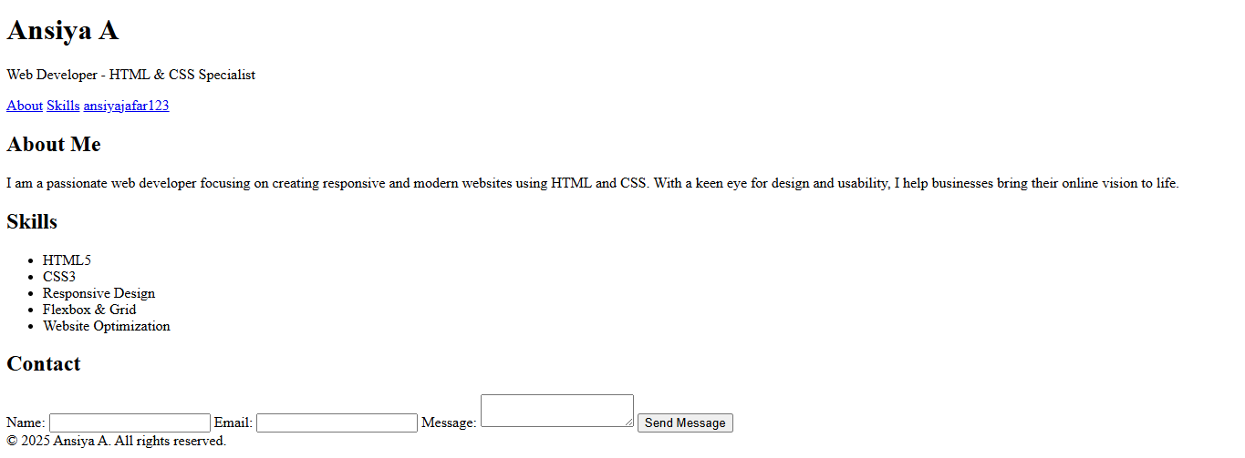

RESULTS AND SCREENSHOTS
Achieved client/business goals through effective feature implementation.
Positive user feedback and increased traffic or conversions (if applicable
Delivered a fully functional, responsive website with improved user engagement.
Enhanced site performance with faster load times and optimized code.
3/21/2024 Annual Review
10

Slide 11
CONCLUSION
Successfully delivered a responsive and user-centric web solution.
Implemented best practices ensuring scalability and maintainability.
Enhanced user experience with optimized performance and interactive features.
Continued improvement and updates planned based on user feedback and evolving needs.
11

